Slide 1
TIME

Slide 2
Inroduction
Time is addressed differently by different people and cultures;
for example, in western culture, time is mainly associated with financial profit, i.e., ‘‘Time is money.’’
Time plays a special role in software engineering: the project schedule should be met, the product should be delivered on time, teammates should complete their tasks on time, and so on.

Slide 3
List of Time-Related Problems in Software Projects
1. Bottlenecks: In software development occur when one or more functions in the process await the output of another function in the process, with teammates having nothing to work on in the meantime.
Eg. when developers wait for artifacts from system analysts, like the specification of a specific module.

Slide 4
List of Time-Related Problems
2. Project planning and schedule. Two main problems are associated with schedules, which are, in fact, closely connected. The first is the mere construction of a feasible project schedule. The second problem is to meet the schedule that has been set.

Slide 5
List of Time-Related Problems
3. Time estimation. There are different ways to support time estimation
(Boehm 1981, Boehm et al. 2000, Kemerer 1987, SEI 2001). With respect to the estimation of the development time of a specific module/class/task, it is well known that the greater the module/class/task is, the more difficult it is to estimate its development time.
Tomayko and Hazzan (2004) present evidence that the smaller the estimated unit is, the more accurate is its time estimation.

Slide 6
List of Time-Related Problems
4.Time pressure. Time pressure is the result of the previous problems. It happens usually toward the end of the development process, when teammates cannot meet the project schedule, either because of poor time estimations or bottlenecks.
Time pressure usually leads to the skipping of different testing activities, which in turn leads to a decrease in software quality.

Slide 7
List of Time-Related Problems
5. Late delivery. Late deliveries occur as a result of inappropriate project planning, usually due to poor estimations.
Data indicate that the percentage of software projects that fail to accomplish on-time delivery is quite high.
See, for example, the data presented by the Standish Group Report (Standish 1994).

Slide 8
Time
Case Study 4.1. Software Organizational Survey from the Time Perspective

Slide 9
Tightness of Software Development Methods
Project plan dimension: number of releases and feedback milestones, level of emphasis placed on planning, number of days for which specific planning is made (the smaller the number of days, the tighter the software development method).
Procedures and standards dimension: level of detail that describes the software development method.
Responsibility and accountability dimension: level of role performance, level of personal accountability, frequency at which team members are required to report on their progress.
Time estimation dimension: importance given to time estimation, resolution level of time estimation (hours, days, months)|the smaller the time units, the higher the resolution, and the higher the value of this dimension.
Individual need satisfaction dimension: mutual dependency of team members, level of planning that inspires the message ‘‘Invest now for the future.’’

Slide 10
Sustainable Pace
Tightness is one time-related characteristic of agile software development. Sustainable pace is another one.
Sustainable pace means that the development process is carried out in a reasonable number of hours, which are well planned and enable the team to be productive and to produce quality products

Slide 11
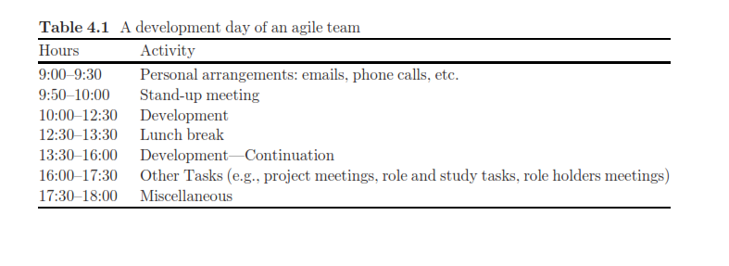
Case Study 4.2. An Iteration Timetable of an Agile Team

Slide 12
Time Management of Agile Projects
1. Time Measurements

Slide 13
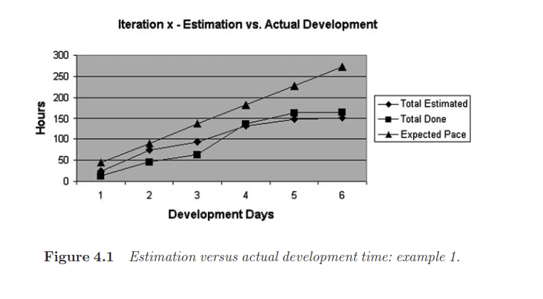
Time Management of Agile Projects

Slide 14
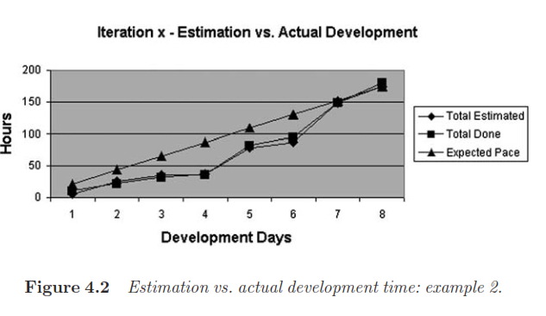
Time Measurements

Slide 15
2. Prioritizing Development Tasks

Slide 16
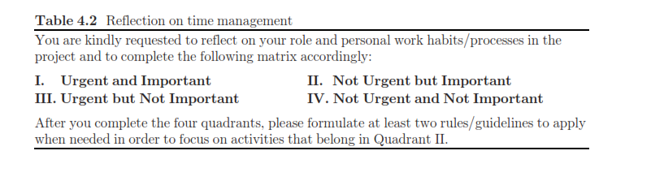
Case Study 4.4. First Things First

Slide 17
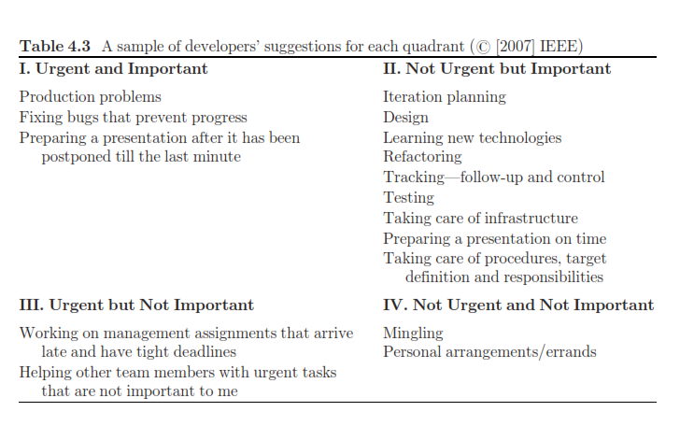
First Things First

Slide 18
Time in Learning Environments
1. The Planning Activity

Slide 19
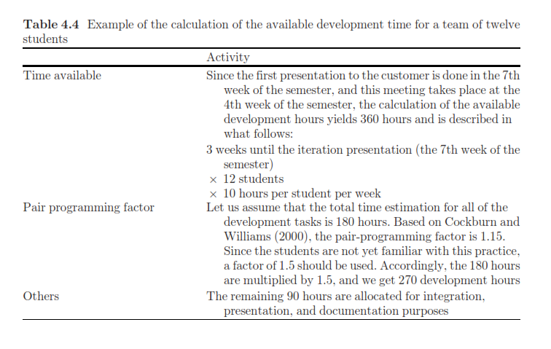
The Planning Activity

Slide 20
2.Teaching and Learning Principles
Teaching and Learning Principle 3: Explain
While Doing
Teaching and Learning Principle 8: Manage Time

Slide 21
3. Students’ Reflections on Time-Related Issues
‘‘MUCH more time should be dedicated to the planning of the structure of the program, both interfaces and implementation, before anyone starts writing any code.’’
‘‘Things usually take more time than expected, especially because of integration and misconceptions |this must be taken into account when estimating times.’’
‘‘As for time evaluation, we met our estimations almost exactly, and in some cases even finished tasks sooner than we had expected.’’
‘‘In iterations 2 and 3 the times were better defined, because of the experience we had gained.’’

Slide 22
4. The Academic Coach’s Perspective
The planning session gives the academic coach an excellent viewpoint on the students’ work with respect to the project’s planning, the design of its parts, and the development management. During the planning activity, the academic coach becomes extensively familiar with the project details and with each student’s part in the development.

